Slide 1
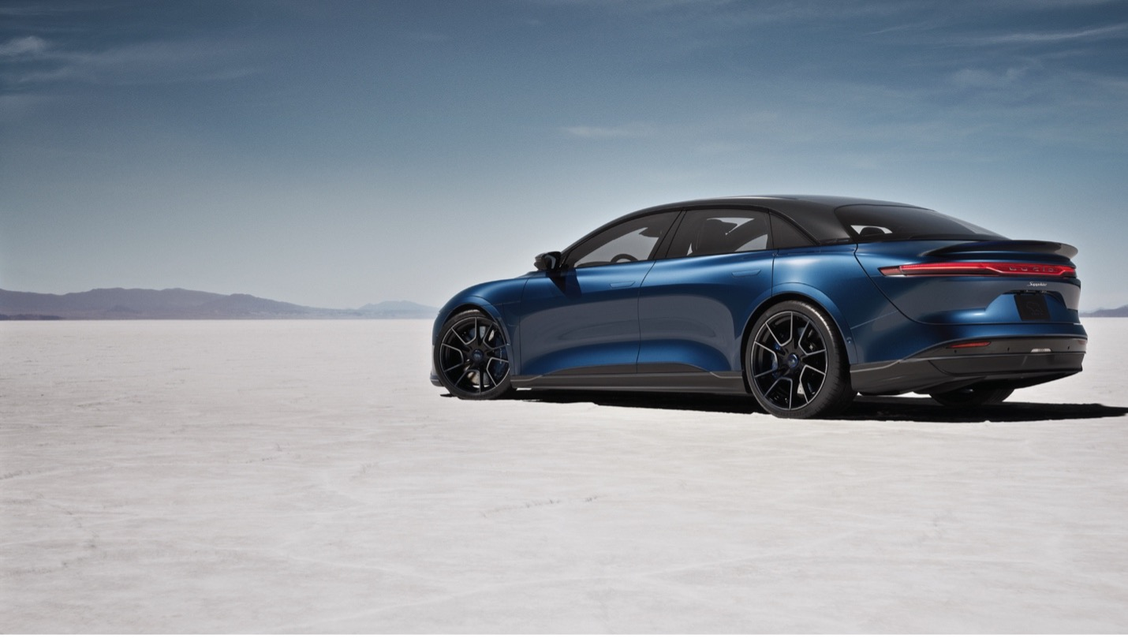
Once in a Lifetime Opportunity...
transforming the automotive industry and the world around us.

Slide 2

Embracing the Entrepreneurial Mind of Unlimited Potential
Our organization wants people who are willing to make calculated risks, who are willing to take a bet not only on the company, but on themselves.

Slide 3
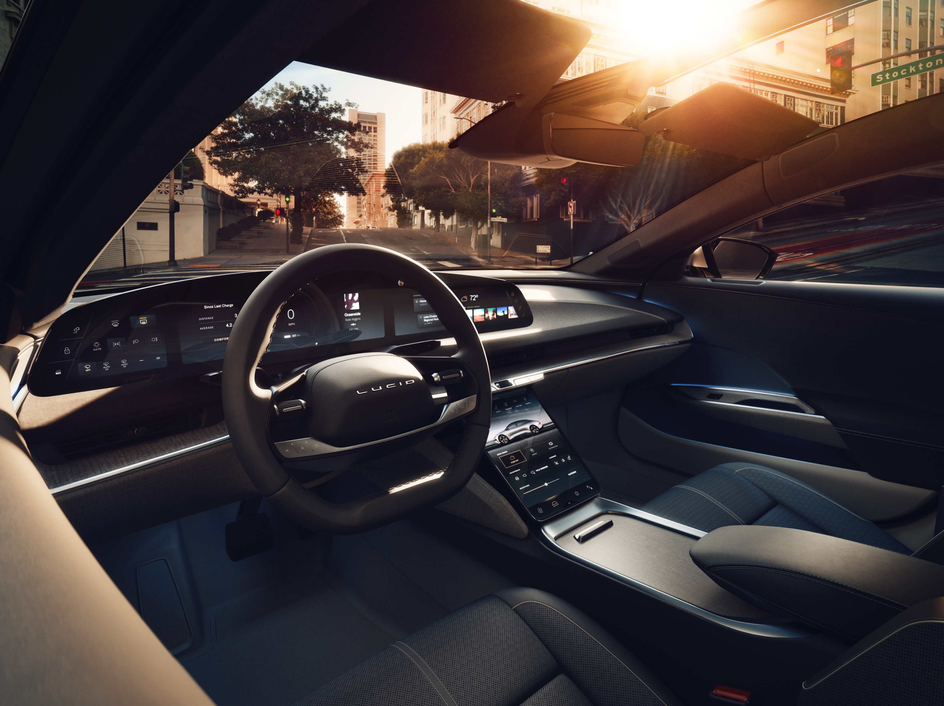
Vision
Inspired by infinite possibilities, we strive to make a profound difference in the world by thinking beyond what is in front of us and designing for a world where life is the most important journey we will ever take.
Mission
At Lucid Motors, we will make an impact on a global scale; to introduce the most captivating luxury electric vehicles and deliver the technologies that compel the world to adopt smarter and more sustainable energy practices – all centered around the human experience.

Slide 4
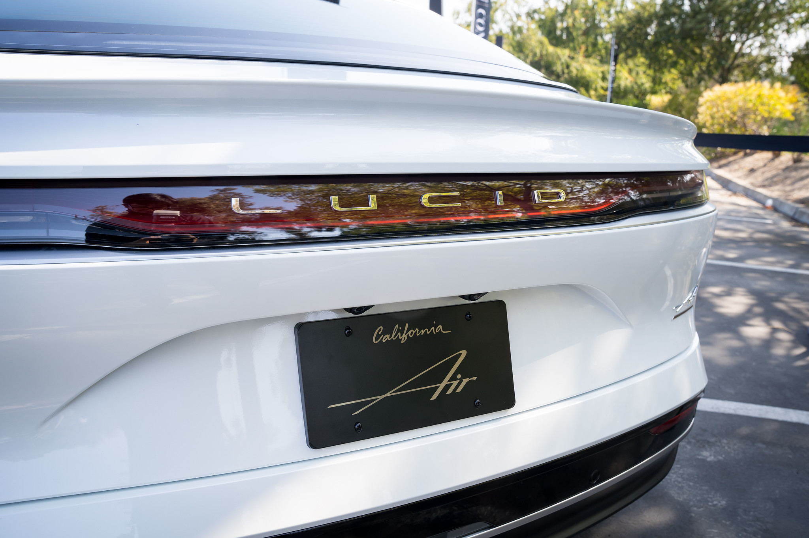
Values
Breakthrough Innovation
One Team
Ownership Mindset:
Passion for Excellence
We design and engineer products and experiences that are visionary, meaningful, and enduring.
We seek diversity of thought and background to inspire the way the world moves forward together as one team.
We are hyper vigilant to deliver results for our customers that profoundly and positively impact our planet.
We anchor on our mission and take accountability for our own and others’ actions unrestrained by role boundaries.
Integrity in Action
Act with Urgency
We have an unwavering commitment to deliver a positive return for our company, our customers, and our communities.
We act promptly and with intention; we move fast, spot and seize opportunities, and do what needs to be done without being asked.

Slide 5
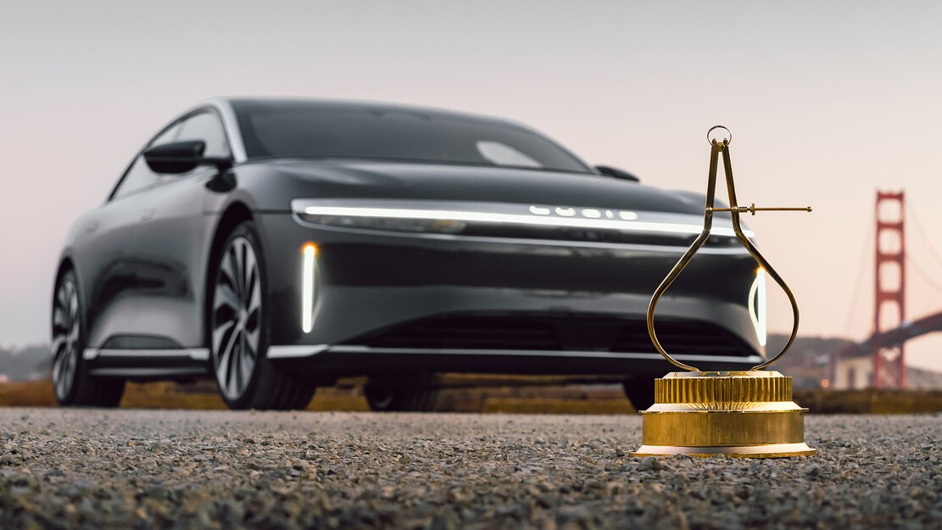
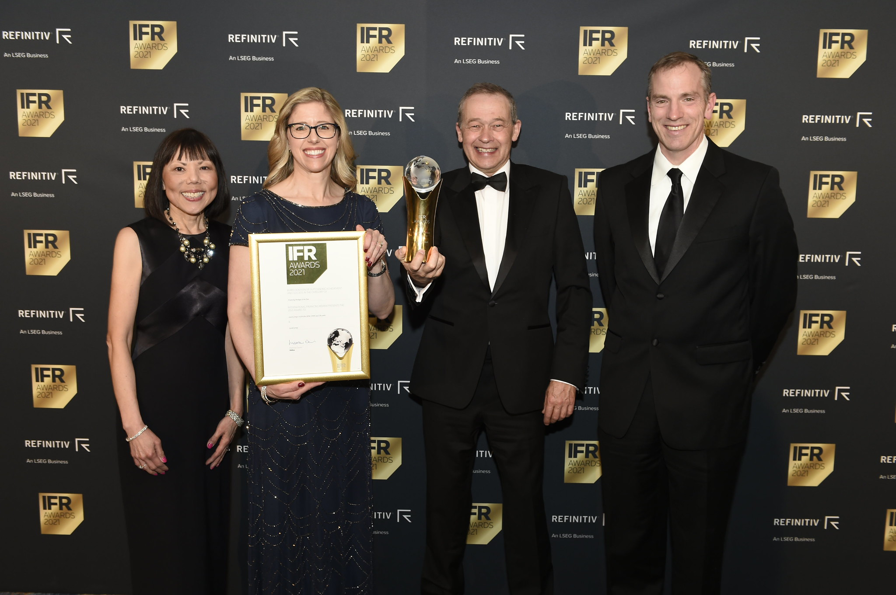
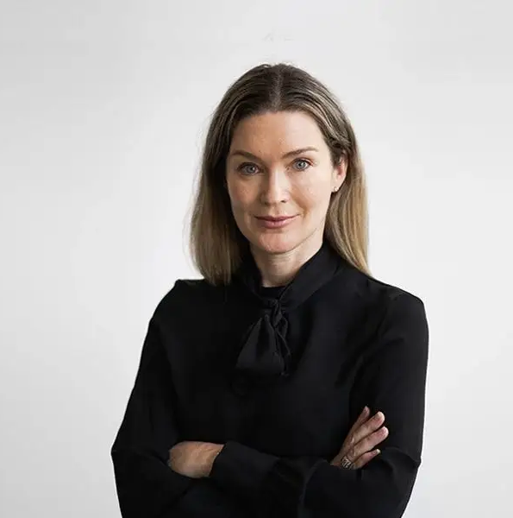
Awards
MotorTrend Car of the Year 2022
Grand Touring Performance Debut and Win at Goodwood UK
Lucid Wins “Wards 10 Best Engines & Propulsion Systems” Award
Lucid Air is our Green Car Reports Best Car To Buy 2022.
Automotive Hall of Fame Awards Ceremony recognizes Lucid’s Sherry House
Lucid’s Margaret Burgraff featured in Business Insider's EV Power Player List

Slide 6
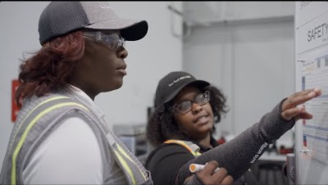
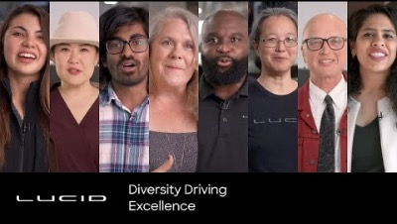
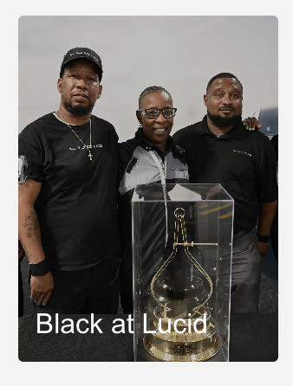




Culture

Slide 7
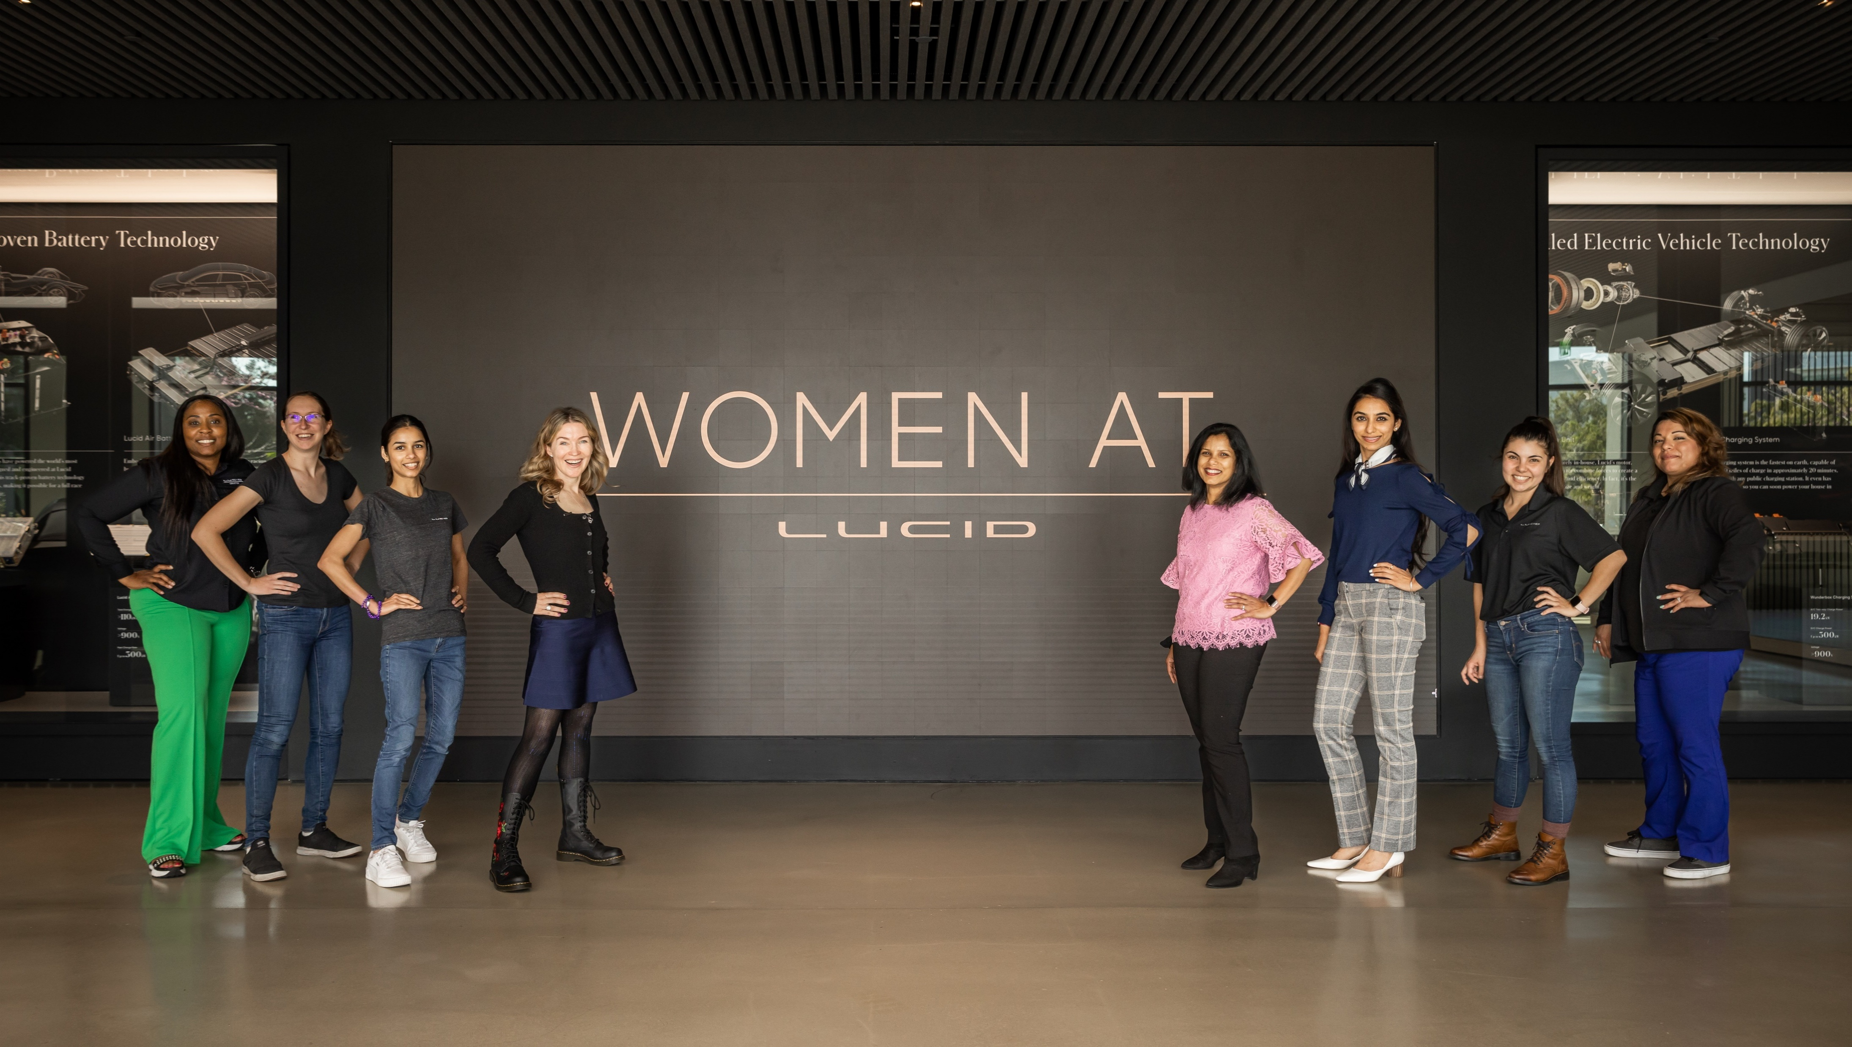
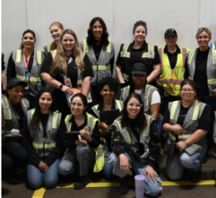
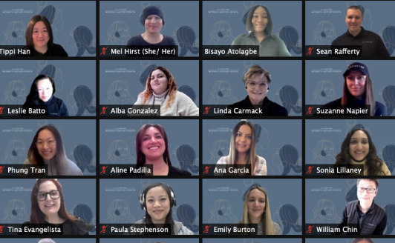
https://www.lucidmotors.com/careers

Slide 8
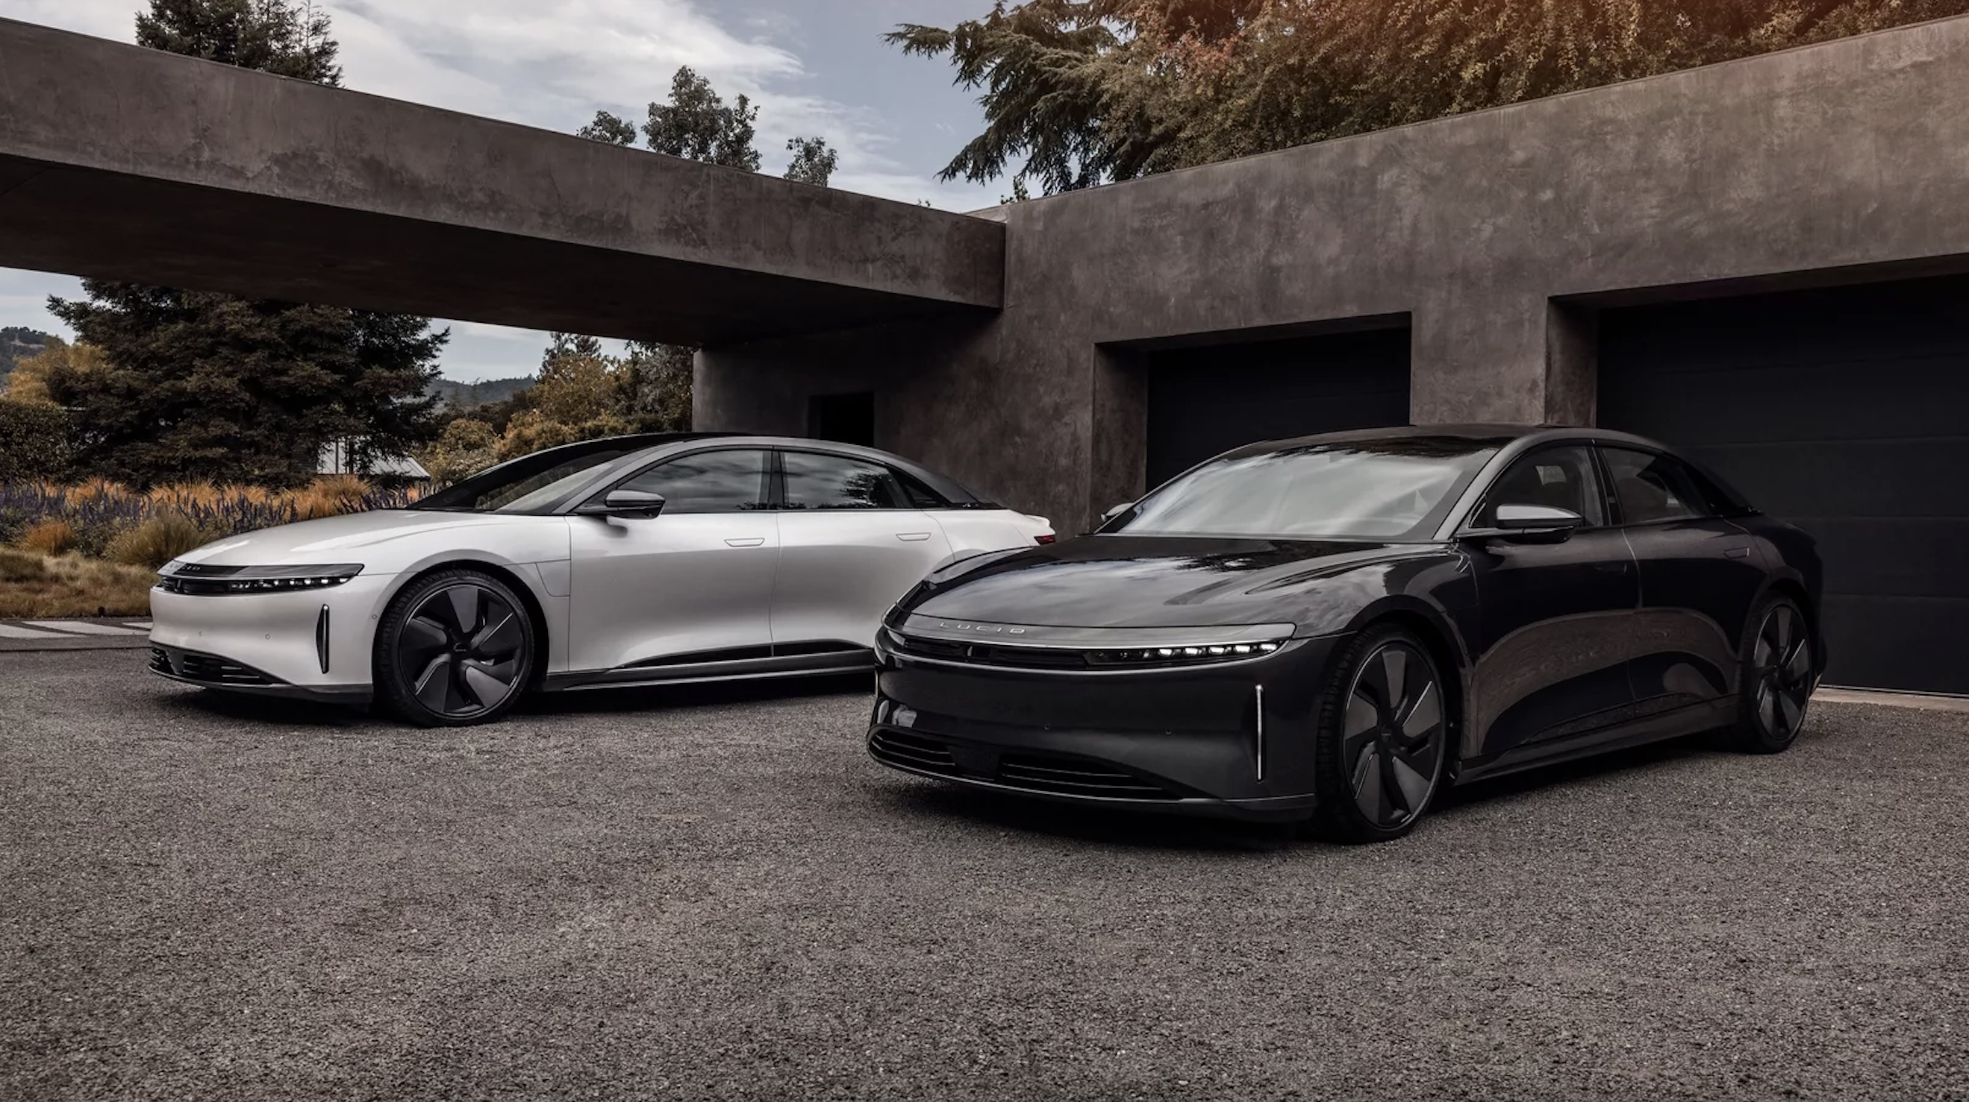
Q&A

