Slide 1

CONFINED SPACE
OPERATIONS
TRAINING
Entrant • Attendant • 4-Gas Monitoring • H₂S Safety
Mixed audience: operators, maintenance teams, contractors, attendants, and supervisors
1
2
3
4
PLAN
MONITOR
PROTECT
RESPOND
Notes:
Introduce the course and emphasize stop-work authority.

Slide 2
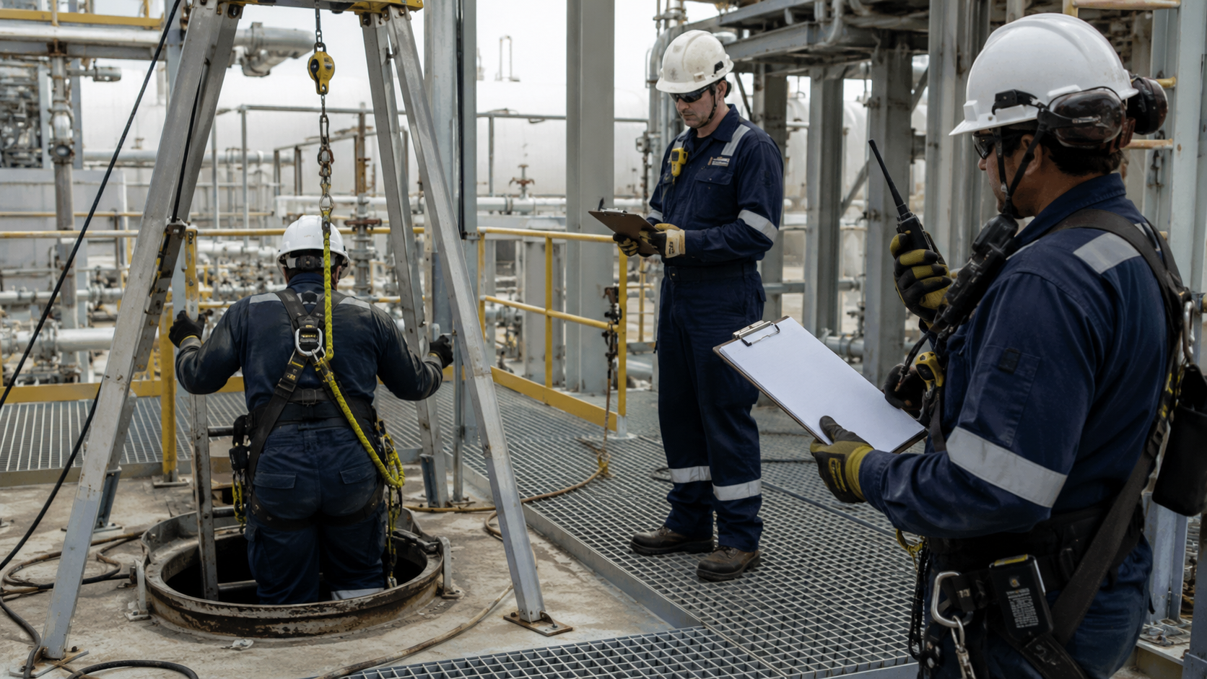
2. ROLES & RESPONSIBILITIES
3
E
ENTRANT
Enters the space, follows procedures, wears PPE, communicates, and exits when ordered or when an alarm activates.
A
ATTENDANT
Remains outside, tracks entrants, monitors conditions, controls access, and summons rescue if needed.
S
ENTRY SUPERVISOR/OPERATOR
Verifies controls and testing, authorizes entry, and cancels the permit when conditions change.

Slide 3
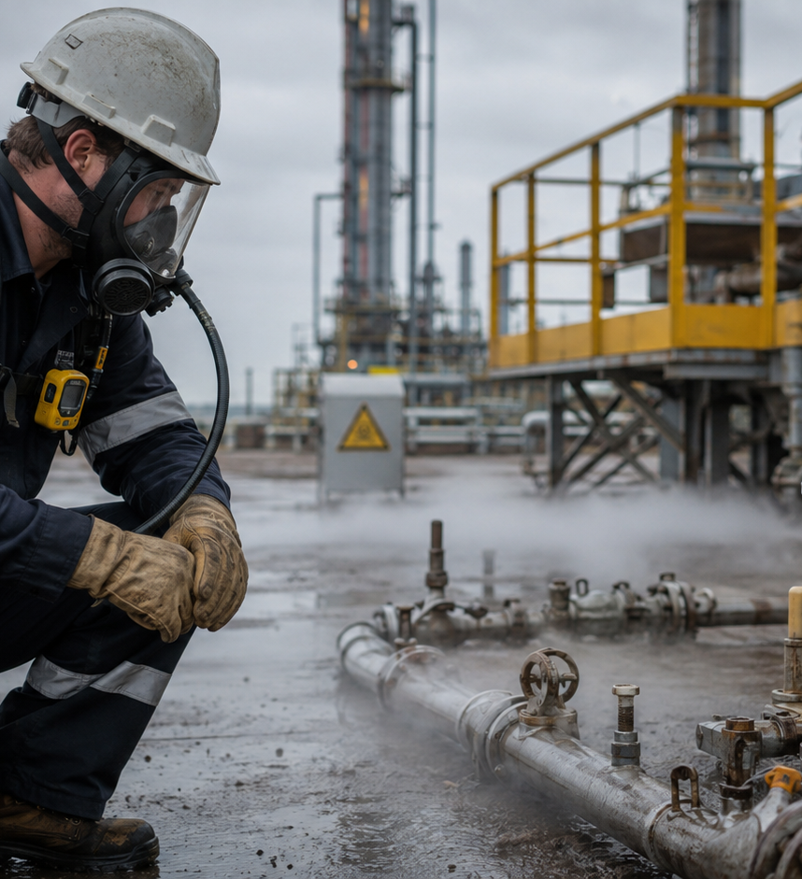
3. CONFINED SPACE HAZARDS
4
ATMOSPHERIC HAZARDS
Oxygen deficiency or enrichment
Flammable atmosphere
Toxic gases such as H₂S or CO
!
PHYSICAL HAZARDS
Engulfment and poor visibility
Heat stress and slippery surfaces
Poor lighting and excessive noise
▲
MECHANICAL / ELECTRICAL
Moving equipment
Electrical shock
Pressurized lines and energy sources
⚙
IF CONDITIONS CHANGE: STOP WORK • EXIT • RE-EVALUATE

Slide 4
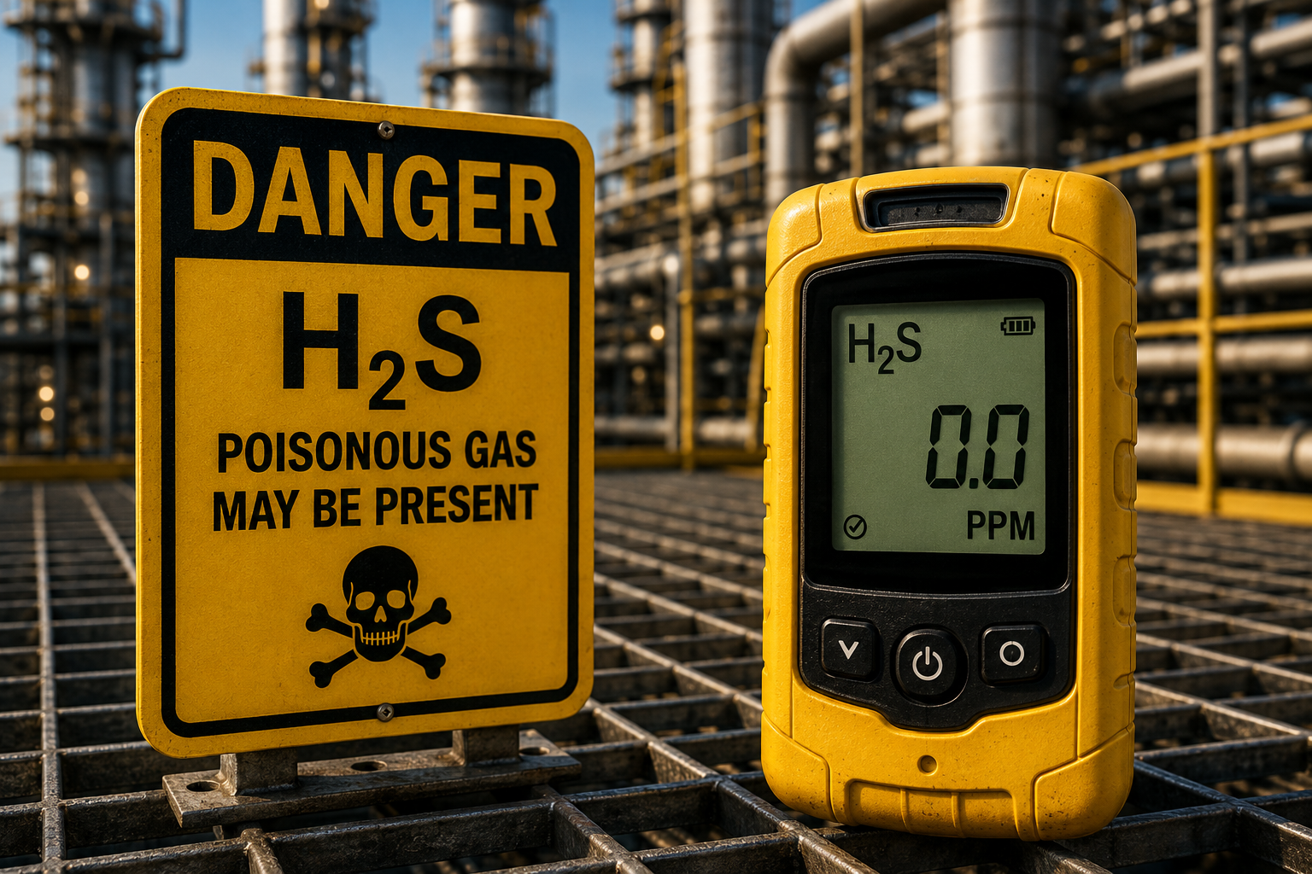
4. 4-GAS METER
5
A 4-gas meter detects four potentially dangerous atmospheric conditions:
O₂
Oxygen
18%
LEL
Combustible gas
Below 10% LEL
CO
Carbon monoxide
Follow site action levels
H₂S
Hydrogen sulfide
Follow site action levels
Do not enter the space. Report the oxygen-deficient atmosphere and follow the site procedure for ventilation and retesting.
BUMP TEST
Before each use
CALIBRATE
Per manufacturer and company policy

Slide 5
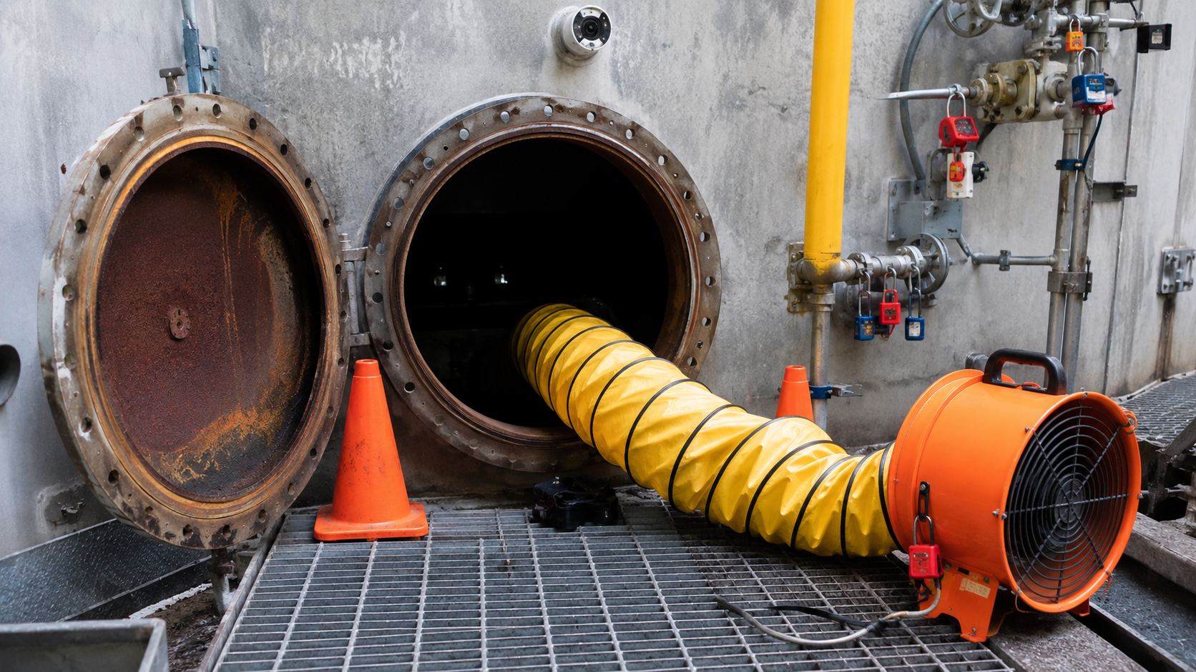
5. CONTINUOUS ATMOSPHERIC MONITORING
6
1
BEFORE ENTRY
Test from the top, middle, and bottom of the space.
2
DURING ENTRY
Continuously monitor while entrants are inside.
3
ALARM RESPONSE
If any alarm sounds, evacuate immediately and investigate.
4
SAFE LIMITS
O₂: 19.5% to 23.5% LEL: <10% CO/H₂S: site action levels
ONE TEST IS NEVER ENOUGH — CONDITIONS CAN CHANGE QUICKLY

Slide 6
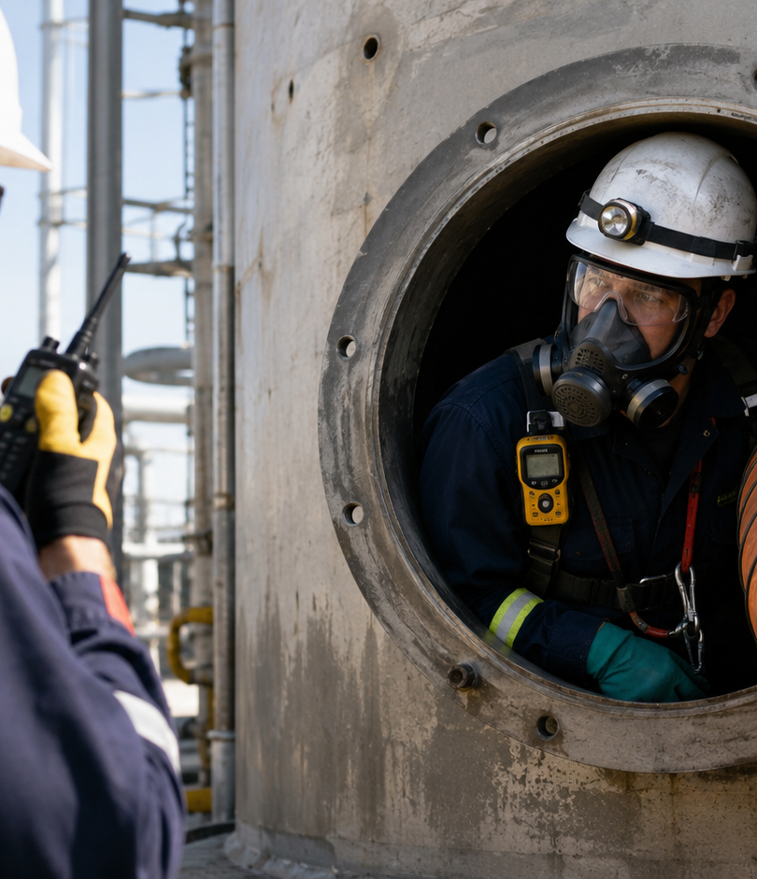
6. HYDROGEN SULFIDE (H₂S) SAFETY
7
H₂S
PROPERTIES
Colorless, toxic, heavier than air, and flammable. Odor is not reliable.
2
EXPOSURE SYMPTOMS
Low exposure: irritation, headache, nausea. High exposure: collapse or respiratory failure.
3
PROTECT YOURSELF
Rely on monitors, follow respiratory-protection rules, evacuate immediately if alarms activate.
NEVER RELY ON SMELL — USE MONITORING AND THE SITE EMERGENCY PLAN

Slide 7
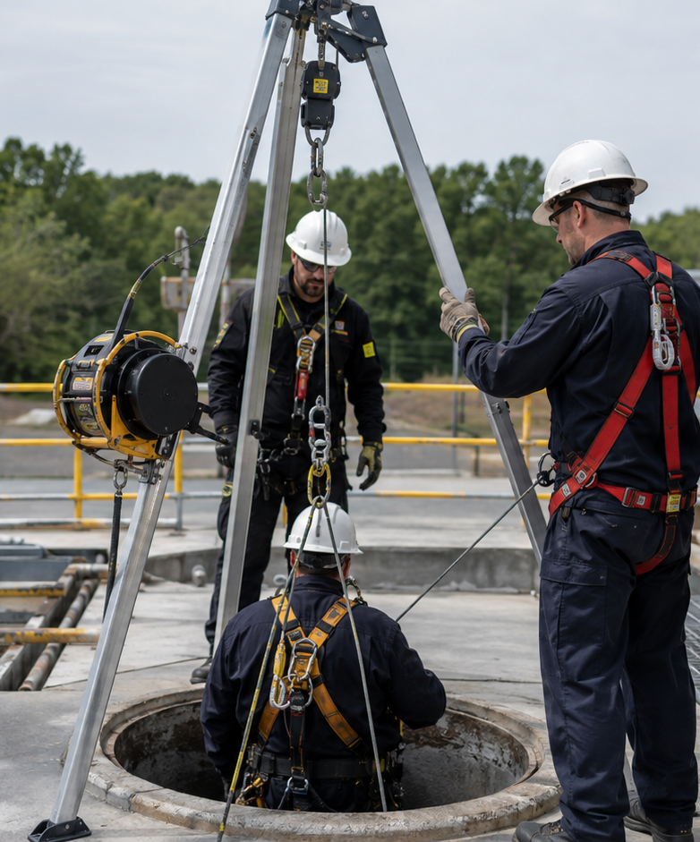
7. EMERGENCY RESPONSE
8
1
STOP WORK
Stop immediately if conditions become unsafe.
2
EXIT IMMEDIATELY
Evacuate and warn others.
3
NON-ENTRY RESCUE
Do not enter unless trained and equipped.
4
COMMUNICATE
Notify the supervisor and emergency response.

Slide 8

8. DECISION POINT: SHOULD YOU ENTER?
9
The entry permit is complete, but the 4-gas monitor has not been bump tested today.
SCENARIO
What should the crew do?
A
Enter because the permit is signed.
B
Enter and test the meter after entry.
C
Delay entry until the monitor is verified operational.
D
Borrow any available monitor without checking it.
Learning point: Stop Work Authority applies before entry begins.

Slide 9
9. DECISION POINT: ATMOSPHERE CHANGES
10
SCENARIO
During entry, oxygen drops from 20.9% to 16.8% and the meter alarms.
1
Exit the confined space immediately.
2
Notify the attendant and supervisor.
3
Do not re-enter until the hazard is eliminated and testing confirms acceptable conditions.
NEVER TROUBLESHOOT THE HAZARD FROM INSIDE THE SPACE.

Slide 10
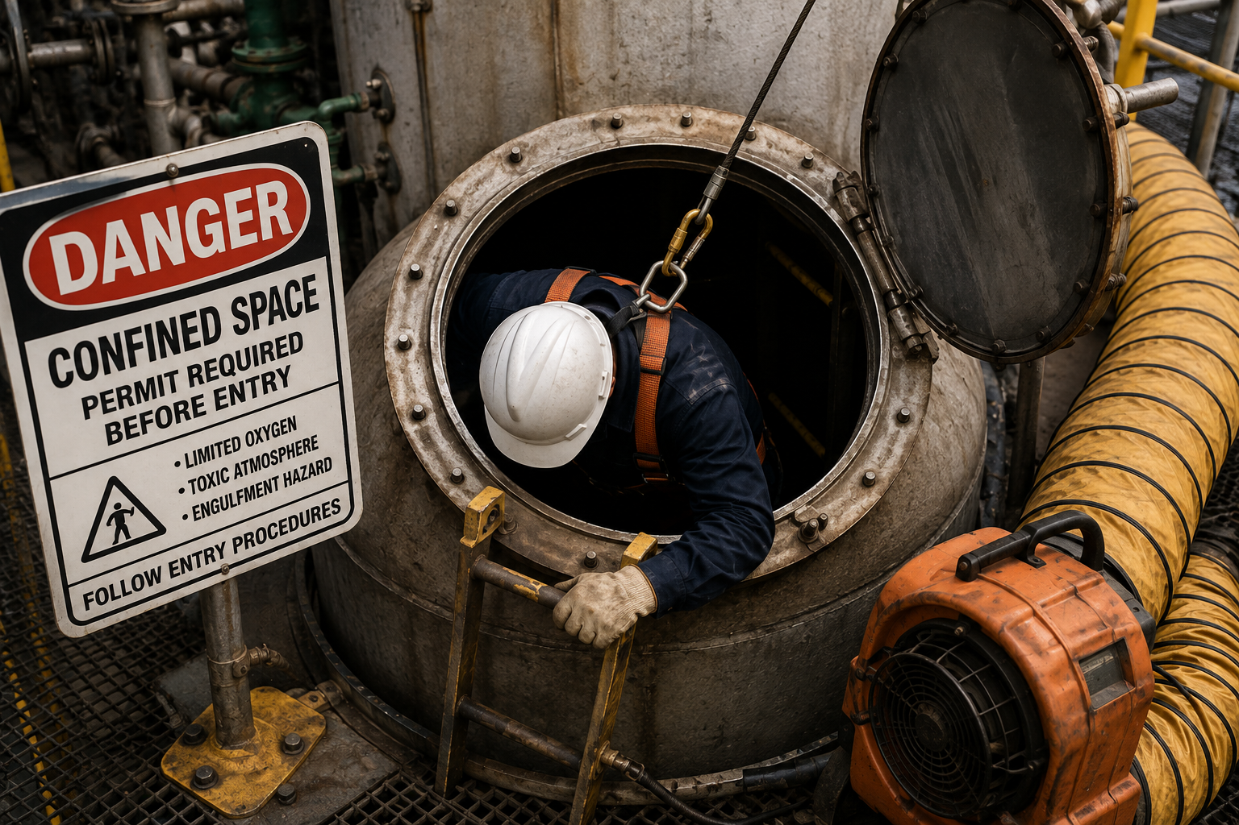
10. PERFORMANCE SUPPORT: ENTRY CHECKLIST
11
BEFORE ENTRY
DURING ENTRY
IF CONDITIONS CHANGE
Permit approved
Continuous monitoring
Stop Work
Hazards identified
Attendant present
Exit immediately
LOTO/isolation verified
Communication maintained
Notify supervisor
Rescue plan reviewed
Permit conditions followed
Activate emergency response
4-gas monitor bump tested
No unauthorized entrants
Secure area
PPE/retrieval equipment inspected

Slide 11
11. KNOWLEDGE CHECK
12
Choose the best answer. Discuss as a group before revealing the answer key.
1. Which gas can cause rapid loss of consciousness and death at high ppm?
A. Oxygen B. LEL C. CO D. H₂S
?
?
2. Who remains outside the space and monitors entrants?
A. Entrant B. Attendant C. Supervisor D. Observer
3. What is the safe oxygen range for entry?
A. 18–21% B. 19.5–23.5% C. 21–25% D. 18–24%
4. If the gas meter alarms during entry, what should be done first?
A. Investigate B. Continue C. Exit immediately D. Increase ventilation
5. What document authorizes permit-required confined space entry?
A. Work Order B. JSA C. Entry Permit D. Safety Checklist
Answer key: 1-D, 2-B, 3-B, 4-C, 5-C

Slide 12
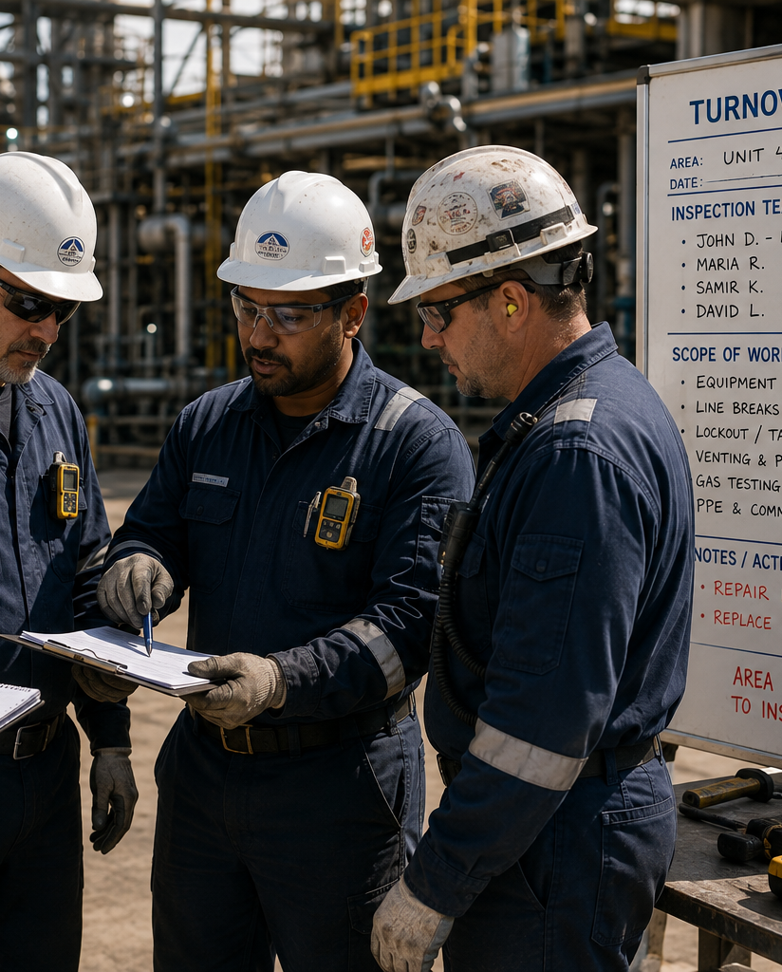
12. FINAL ASSESSMENT
13
Match each responsibility to the correct role.
Responsibility
Entrant
Attendant
Supervisor
Wears PPE
✓
Maintains entrant count
✓
Authorizes entry permit
✓
Exits when alarm activates
✓
Prevents unauthorized entry
✓
Cancels permit
✓
True / False:
H₂S can deaden your sense of smell.
Continuous monitoring should continue throughout entry.
Workers have Stop Work Authority.
Answer Key: All True

Slide 13
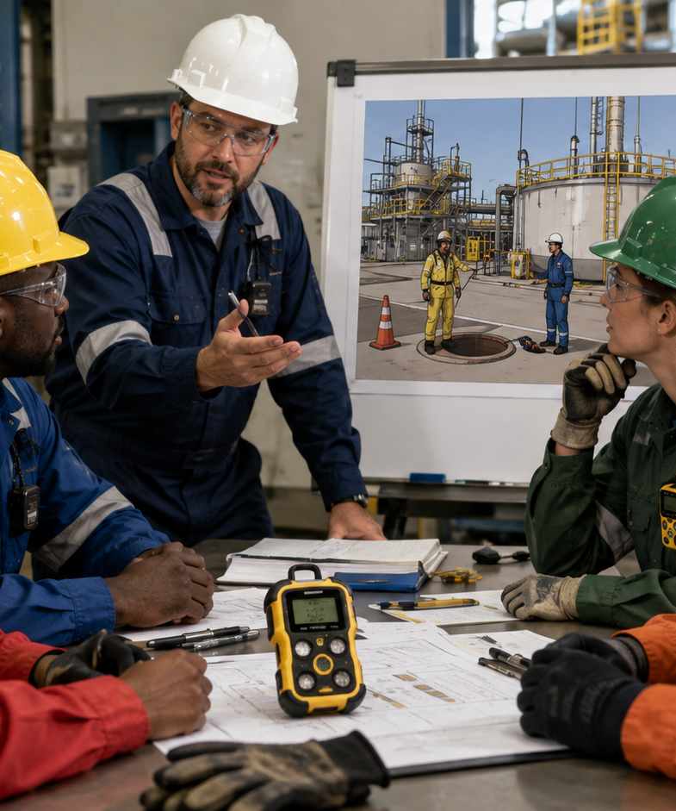
13. FACILITATOR GUIDE
14
Audience
Operators, maintenance teams, contractors, attendants, and supervisors.
Duration
20–25 minutes with discussion and scenario questions.
Materials
Entry permit, 4-gas monitor, PPE/harness, rescue plan, site procedure.
Method
Instructor-led toolbox style, discussion-based, with a performance-support checklist.
Evaluation
Knowledge check, final assessment, and supervisor observation on the job.

Slide 14

14. KEY TAKEAWAYS & SAFETY COMMITMENT
15
✓
Plan the work and control hazards.
✓
Verify and monitor the atmosphere.
✓
Know your role and follow procedures.
✓
Use equipment properly and communicate.
✓
H₂S can kill — monitor and stay alert.
✓
Stop work if conditions are unsafe.
SAFETY IS EVERYONE’S RESPONSIBILITY.
WORK SAFE. GO HOME SAFE.

Slide 15
15. SOURCE & DESIGN NOTES
16
Primary Regulatory Reference
OSHA 29 CFR 1910.146 — Permit-Required Confined Spaces.
Atmospheric testing sequence: oxygen, combustible gases/vapors, then toxic gases/vapors.
Oxygen-deficient atmosphere: below 19.5%. Oxygen-enriched atmosphere: above 23.5%.
Company/site procedures determine alarm set points, H₂S response levels, respiratory protection, and rescue procedures.
Portfolio positioning: This deck demonstrates instructor-led training design, scenario-based decision points, role-specific responsibilities, field-checklist performance support, and assessment alignment for high-risk industrial operations.
Confined Space Operations Training | Portfolio Sample | Amanda Smith, M.S.Ed.

