Slide 1

Rue Gilt Groupe
LUXURY EXPERIENCE
ELEVATING CUSTOMER SERVICE TRAINING

Slide 2
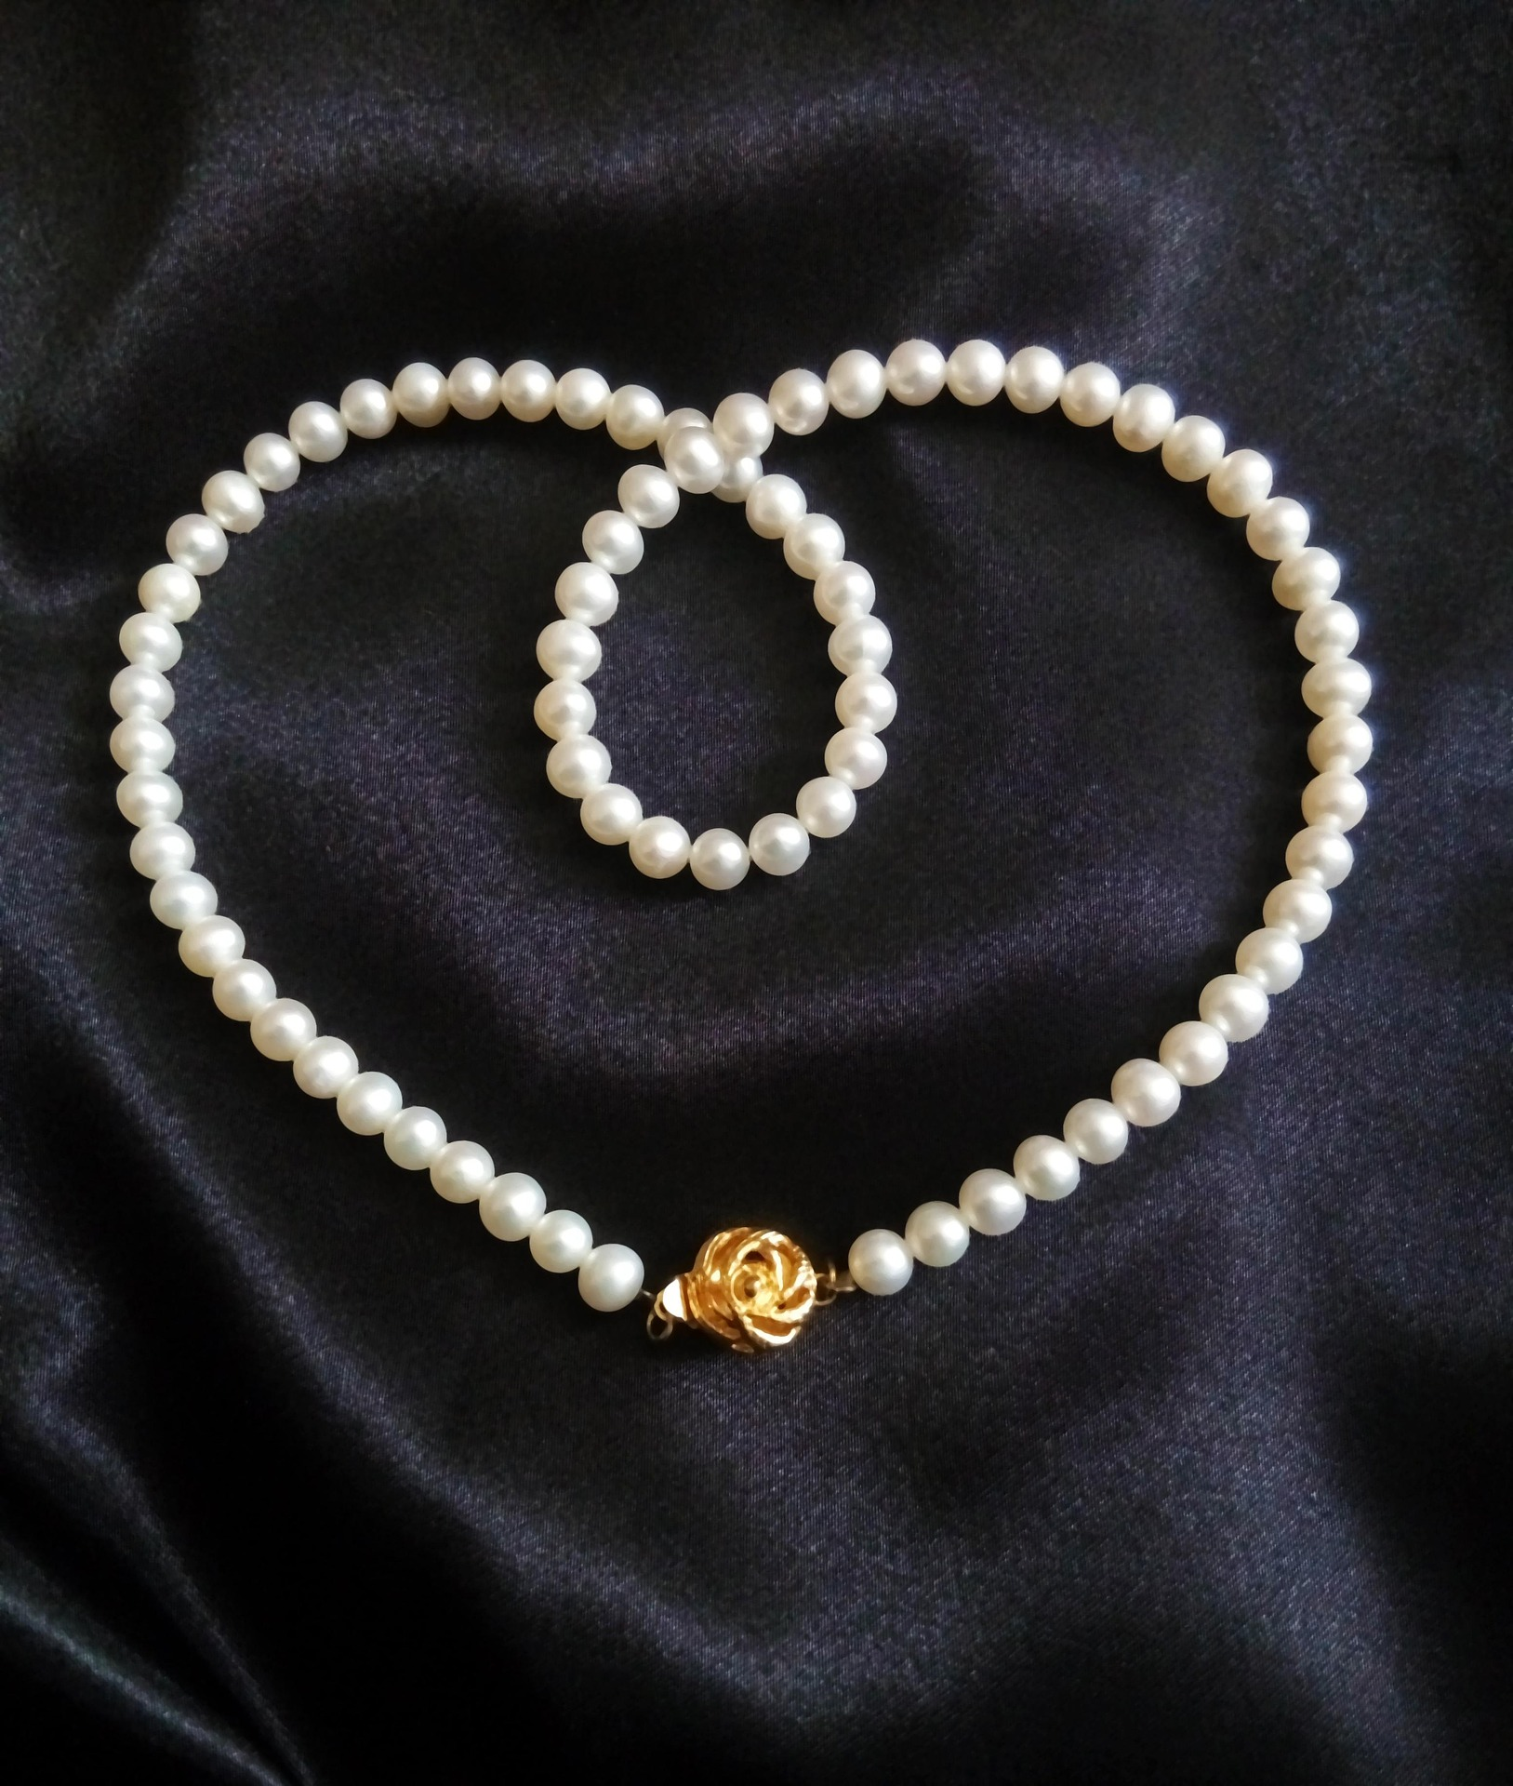
INTRODUCTION
The Luxury Experience Journey is a strategic initiative designed to bridge the gap between technical proficiency and emotional mastery.
By redefining our approach to training, we ensure that every interaction reflects the heritage, exclusivity, and personalized attention synonymous with our brand's global prestige.

Slide 3
PROGRAM CORE OBJECTIVES
ELITE ONBOARDING
REAL WORLD SCENARIOS
SCALABLE MASTERY
Immersing new talent into the brand’s DNA from Day 1 to ensure cultural alignment and service consistency.
Simulation and gamification in a safe, controlled space practicing empathy and problem solving.
A modular system designed to grow with the agent, moving from basics to high-net-worth relationship management.

Slide 4

CENTRALIZED LEARNING
The Hub providing 24/7 access to resources and tools.
OnboardingDemo

Slide 5

MENTORSHIP
“Mentorship is the cornerstone of passing the legacy of luxury from one generation of service to the next”
Pairing rising stars with veteran ambassadors to foster a culture of coaching, refinement and shared wisdom.

Slide 6
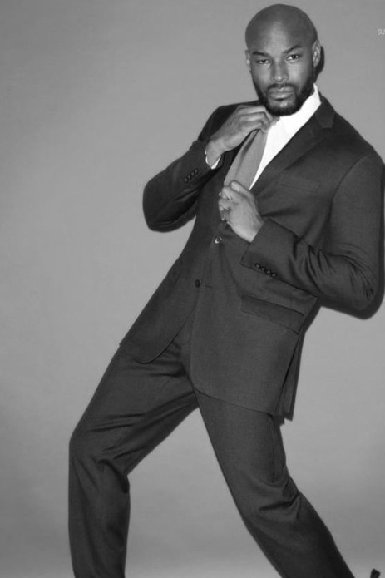
FEEDBACK ECOSYSTEM
360 Feedback loop ensures data-driven refinements
Week 6
Mastery Evaluation
Week 3
Interaction Analysis
Week 1
Baseline

Slide 7

STRATEGIC ROADMAP
PHASE 1
LAUNCH
PHASE 2
EXECUTION
PHASE 3
SCALING
Selection of employees for initial onboarding and brand immersion.
6 - Week training cycle featuring self-directed micro and eLearning, weekly coaching, 24/7 resources.
Outcome analysis and feedback integration for company-wide implementation.

Slide 8
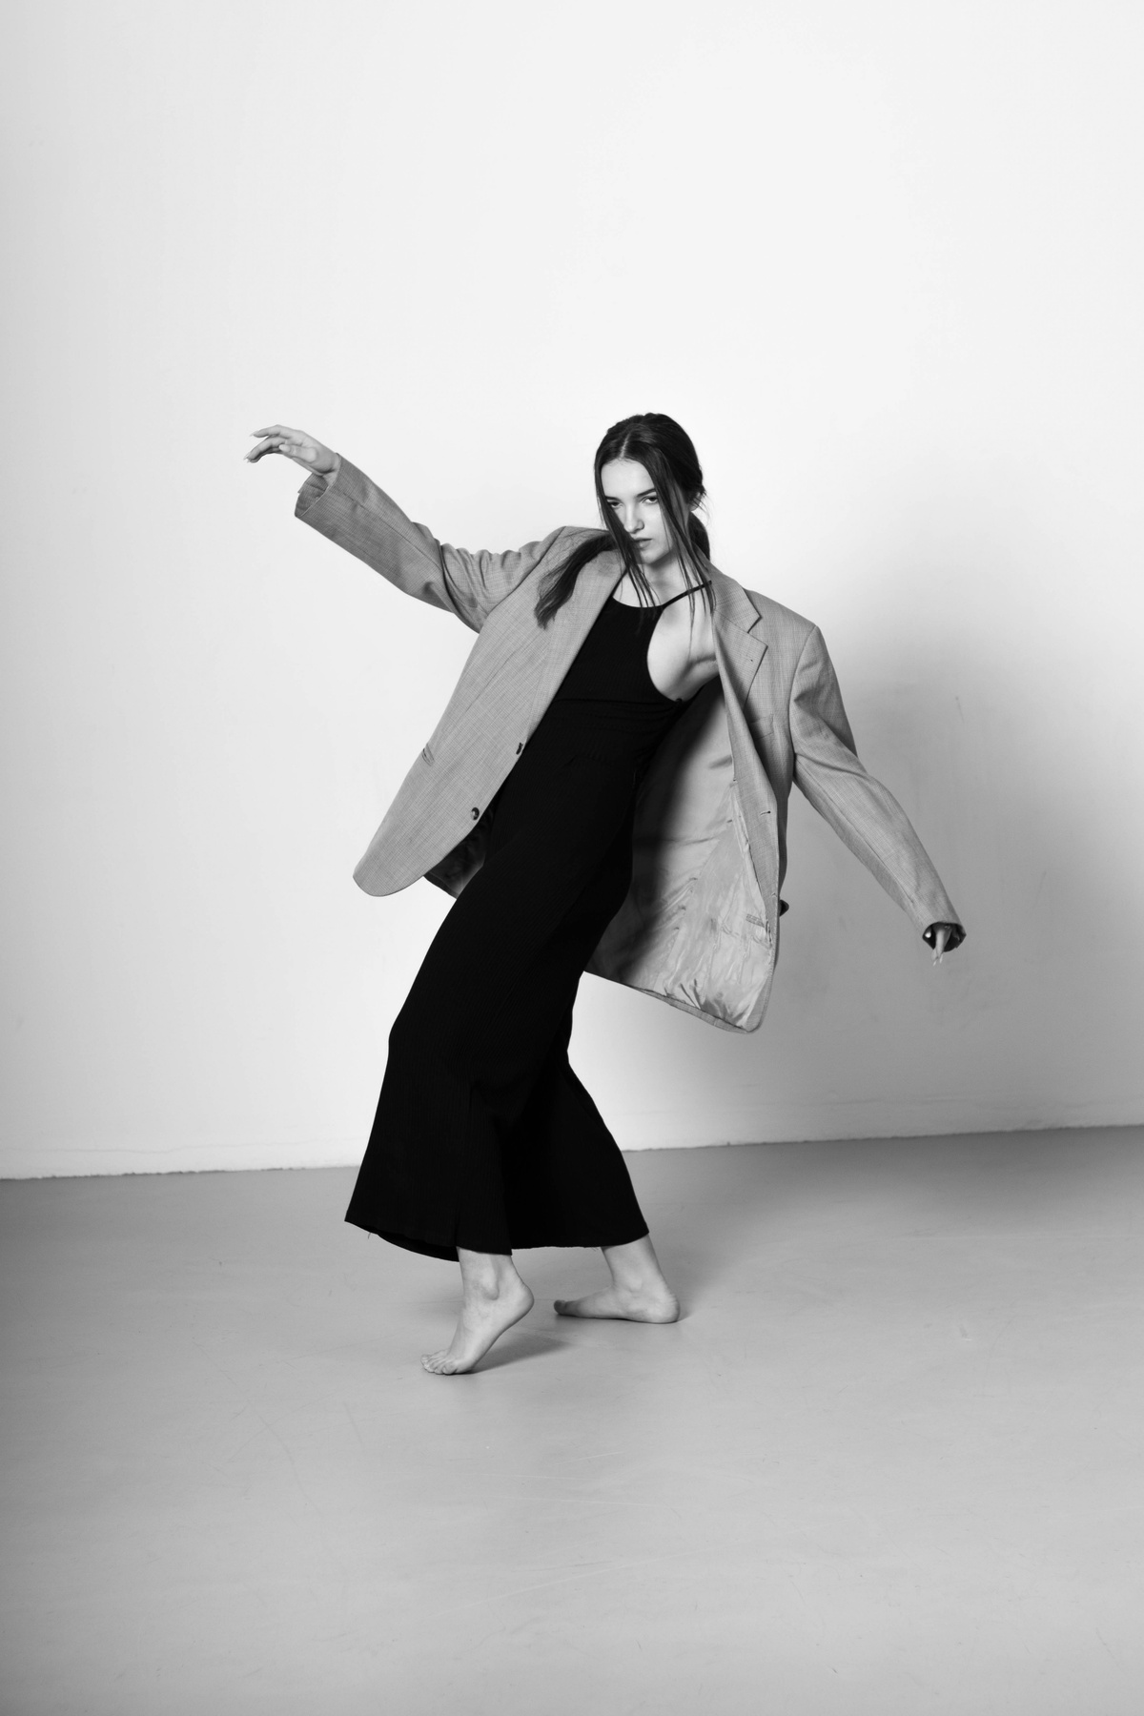
SUCCESS TARGETS
Onboarding Efficiency
+20%
Employees learn quicker, build confidence and make fewer errors
Employee Retention
+10%
Direct byproduct of onboarding efficiency
Customer Satisfaction
+15%
Direct byproduct of better training
Measurable impact on brand equity through operational excellence.

Slide 9

The Luxury Experience is more than training;
it’s a commitment to excellence and to brand future.

Slide 10

THANK YOU
About Me
Amanda Smith, MSEd.

