Slide 1

Nursing Simulation
Education Plan
For

Slide 2
Agenda
Vision and Mission
Program Goals
Overview of Healthcare Simulation
Pedagogy for Simulation
Standards of Practice
Program Plan
Strategies for Community Outreach
Resources Required for Program Success

Slide 3

Vision
To provide a nursing program that is designed with the critical elements key to the nursing profession ensuring quality instruction, learning and successful student outcomes utilizing a simulation technical tool.

Slide 4
Mission
To develop a 5-year simulation educational program that prepares students for the graduate licensing exam (NCLEX) in nursing and for employment in a variety of healthcare settings.

Slide 5
Program Goals
To utilize simulation software in order to model real life conditions in a safe, controlled environment.
To use technology as an aid for training and assessing clinical knowledge.
To create a standardized setting for critical thinking, problem solving and decision-making skills.
To partner with community agencies in order to address the increasing need for healthcare workers.

Slide 6
Overview
Healthcare simulation is an educational approach grounded in learning theories. It is a learner-centered, outcome driven approach, based most often on the theory of constructivism.

Slide 7
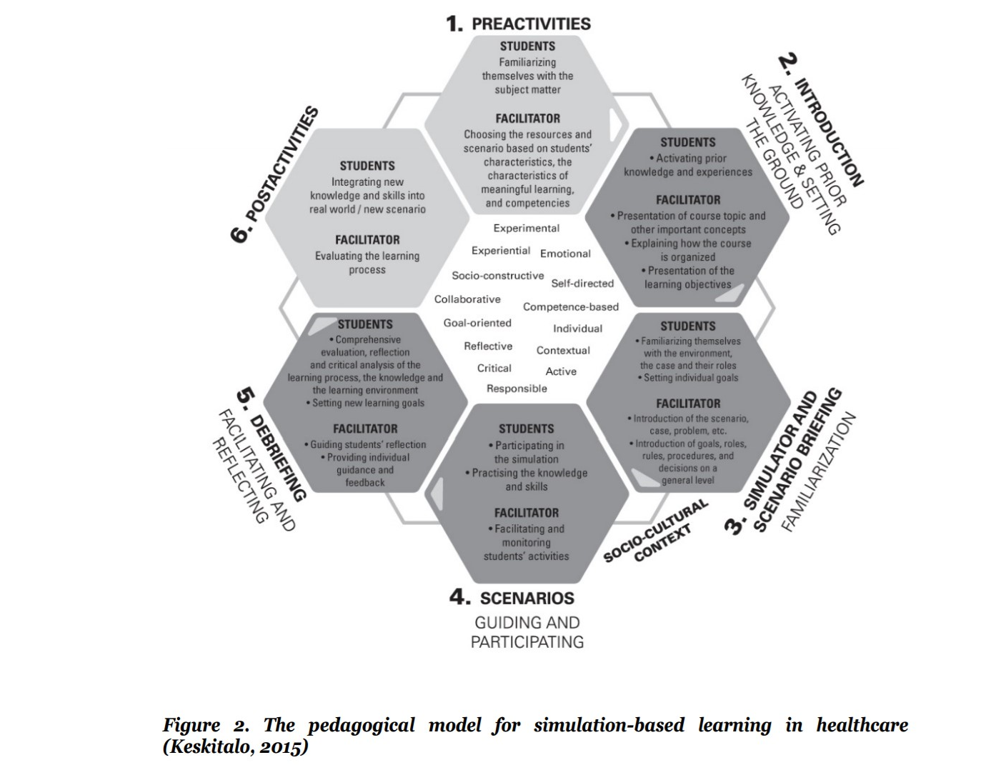
Keskitalo, T. (2015). Designing a pedagogical model simulation-based healthcare education. Acta Universitatis Lapponiensis 299. Rovaniemi: Lapland University Press.

Slide 8
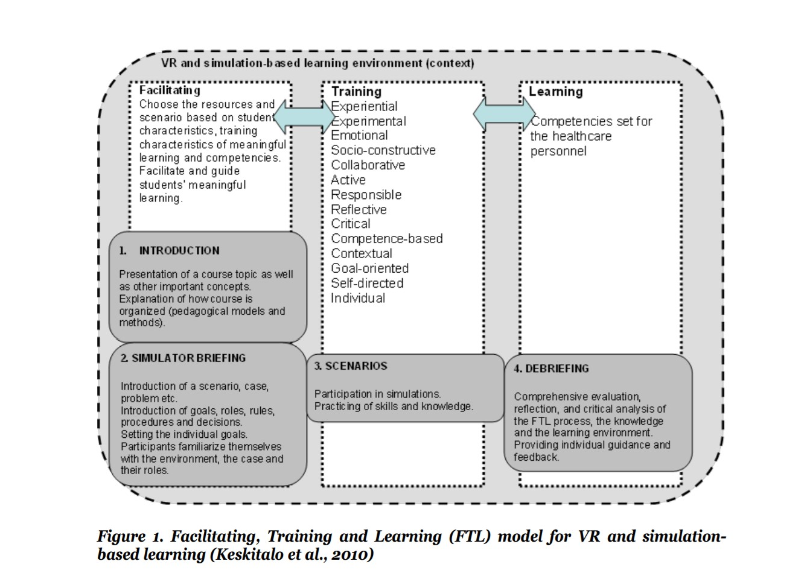
Keskitalo, T., Ruokamo, H., & Väisänen, O. (2010). How does the facilitating, training and learning model support characteristics of meaningful learning in a simulation-based learning environment from facilitators’ and students’ perspectives? Proceedings of ED-Media 2010: World Conference on Educational Multimedia, Hypermedia & Telecommunications. June 27–July 1, 2010, Toronto, Canada (pp. 1736–1746). Chesapeake, VA: AACE.

Slide 9
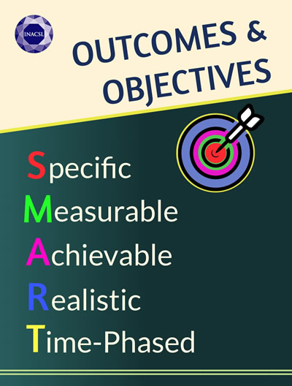
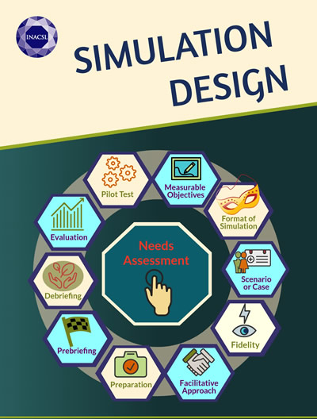

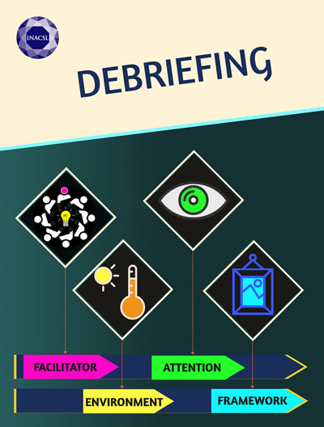


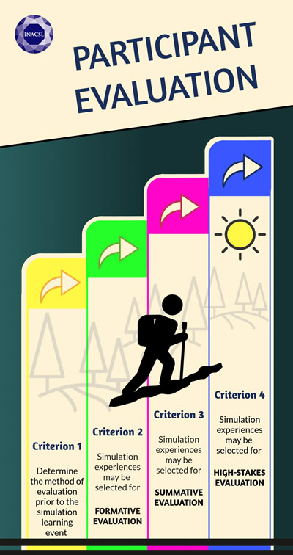

Standards of Practice

Slide 10
Strategies for Community Outreach
Communicate with stakeholders
Seek thought leaders
Showcase program in a career fair or educational seminar
Partner with local agencies
Celebrate successes
Send out a program newsletter
Offer a program scholarship or have a contest
Ask for donations for student supplies
Create volunteer opportunities
Visit local high schools to recruit

Slide 11
Program Plan
Needs Assessment/Enlist Stakeholders/Form Committee
Research/Collect Data
Evaluation
Formulate Plan /
Align Objectives to Mission
Implementation /
Progress Tracking

Slide 12
Resources Required for Program Success
Faculty commitment
Adequate supplies and equipment
Sufficient classroom space
Staff and student orientation
Faculty continuity
Tech support
Budget to support expansion and scope of program

Slide 13
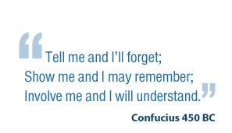
Thank you!

